Slide 1



Virat kohli dashboard
View in Power BI
Last data refresh:
6/3/2024 11:43:31 AM UTC
Downloaded at:
6/3/2024 11:45:06 AM UTC

Slide 2
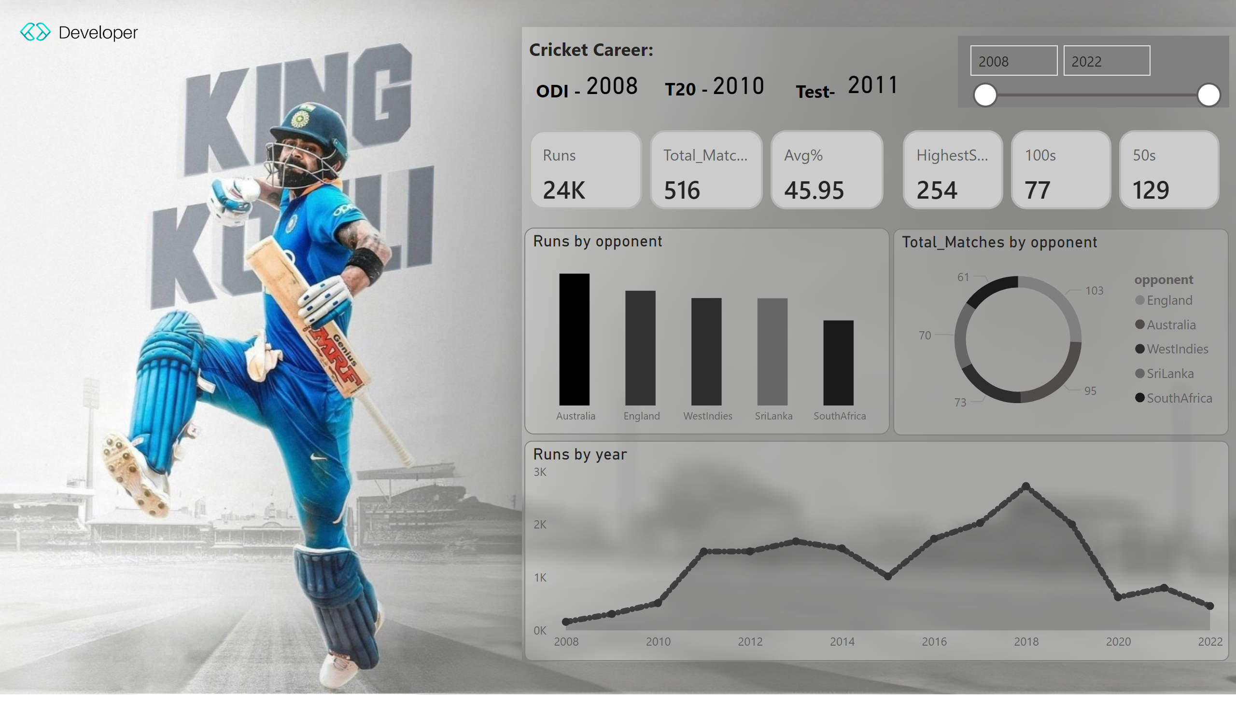
Virat Kohli
Notes:
cardVisual
No alt text provided
cardVisual
No alt text provided
columnChart
No alt text provided
donutChart
No alt text provided
stackedAreaChart
No alt text provided
slicer
No alt text provided
card
No alt text provided
shape
No alt text provided
shape
No alt text provided
card
No alt text provided
textbox
No alt text provided
shape
No alt text provided
card
No alt text provided

